Slide 1

International Conference on “Social Sciences Analytics with Big Data (ICSSABD - 26)”
- Keynote Speaker
“Amanullah Khan Ameer Khan”
Technical Manager , HCLTech
Held on 14-Mar-2026, over virtual Zoom Conference.
Reporter:XXX
Date:20XX-XX-XX
Created By AI

Slide 2
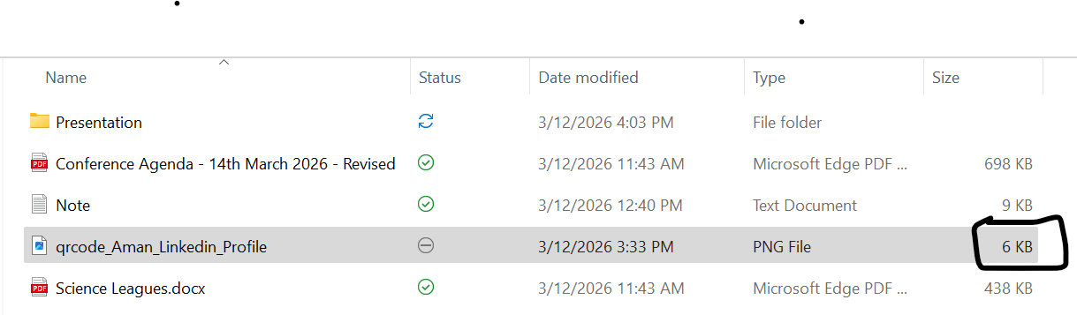

“
Speaker Introduction
Professional Summary & Background
Techno-Functional Leader | Data Platforms - Strategy , Operations & Delivery
14-Years of Driving data excellence across Industries , Businesses and Clients with exemplary expertise spanning across 3-Multi National Organizations- "DXC, Accenture, and HCLTech" .
1× Accenture High Performer Honor | 2× Maybank Plaque Honor | 6× HCL Distinct Performer Honor |HCL League of Achievers Inductee. Deep-domain experience in Banking/FMCG/Healthcare/Retail/Real Estate Industries . Orchestrated complex Client & Stakeholder management over landscapes across APAC, EMEA, ASEAN, and North America (NA) regions . Helped clients leverage their technological landscapes on Data-Platforms to generate high ROI on their Business-to-Technology Funding Outcomes. Detailed summary available on LinkedIn: https://www.linkedin.com/in/amanullah-khan-ameer-khan-0bb4a749/.

Slide 3
“
Forenote – “Social Sciences with Bigdata”
Nature of Data – Analog v/s Digital
Digitalization What Quantifies Big Data ?
Social Sciences with Big Data

Slide 4
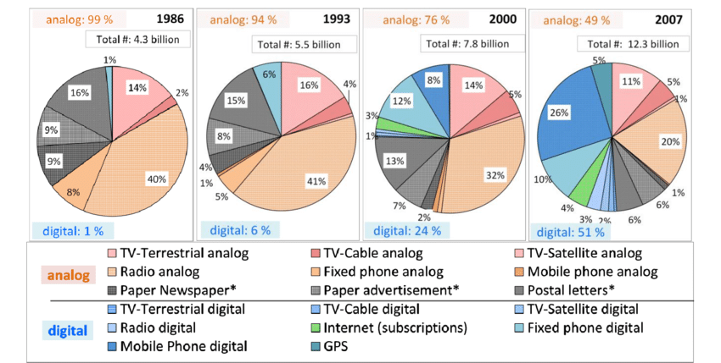
A Step Back to Big Data- Bombardment of Information
Evolution from Analog records to Digital Traces
Citation : https://www.researchgate.net/publication/263120835_What_Is_the_Content_of_the_World's_Technologically_Mediated_Information_and_Communication_Capacity_How_Much_Text_Image_Audio_and_Video

Slide 5
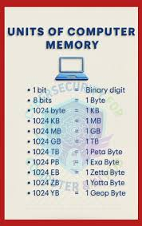
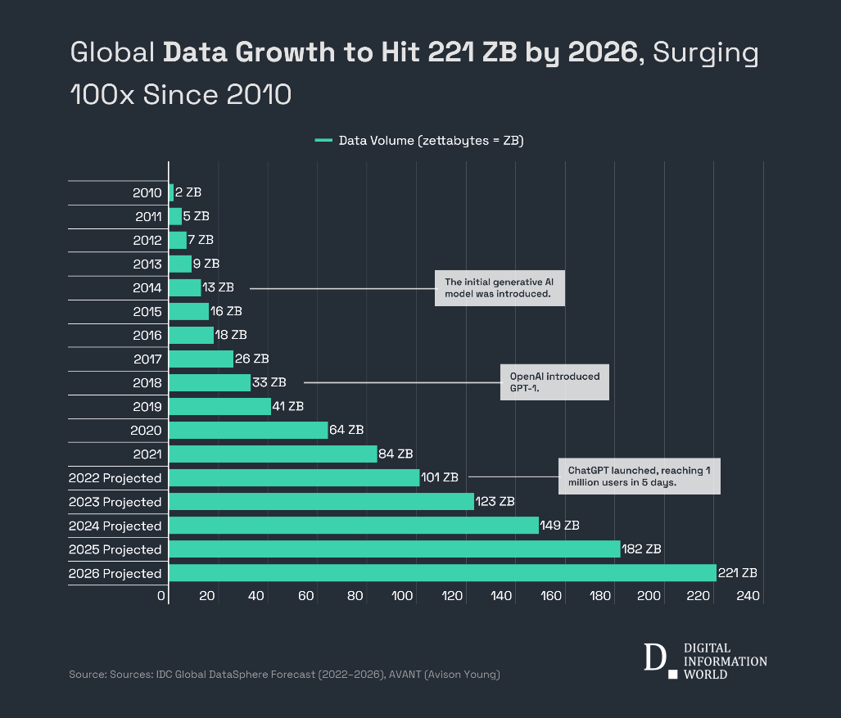
A Step Back to Big Data- Bombardment of Information
Evolution from Analog records to Digital Traces
Citation :
IDC Global DataSphere Forecast 2024-26

Slide 6
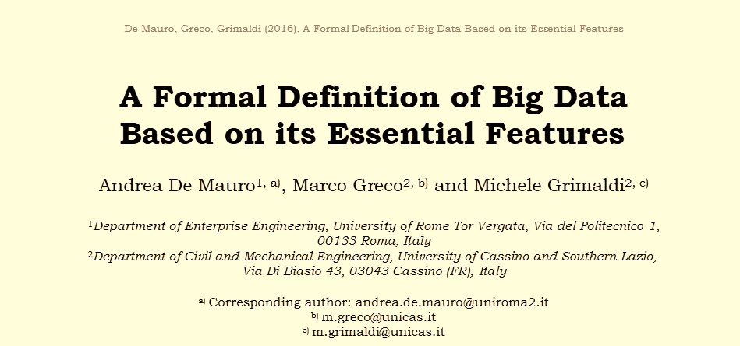
Big Data- Concept , Scope and Relevance
https://www.researchgate.net/publication/299379163_A_formal_definition_of_Big_Data_based_on_its_essential_features
The Fuel of Big Data: Information (Vareity , Volume, Velocity)
Equipment for Working with Big Data: Technology (Inferring Veracity)
Transforming Big Data in Value: Methods (Value)
How Big Data Changes our Lives: Impact

Slide 7
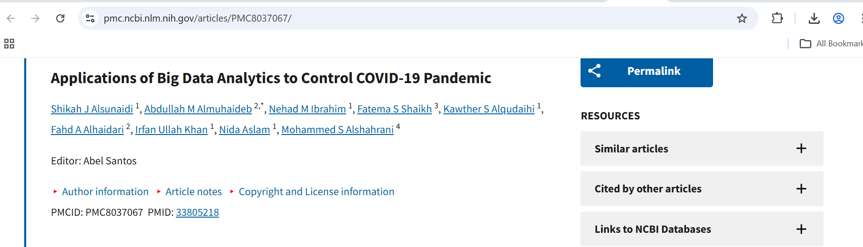
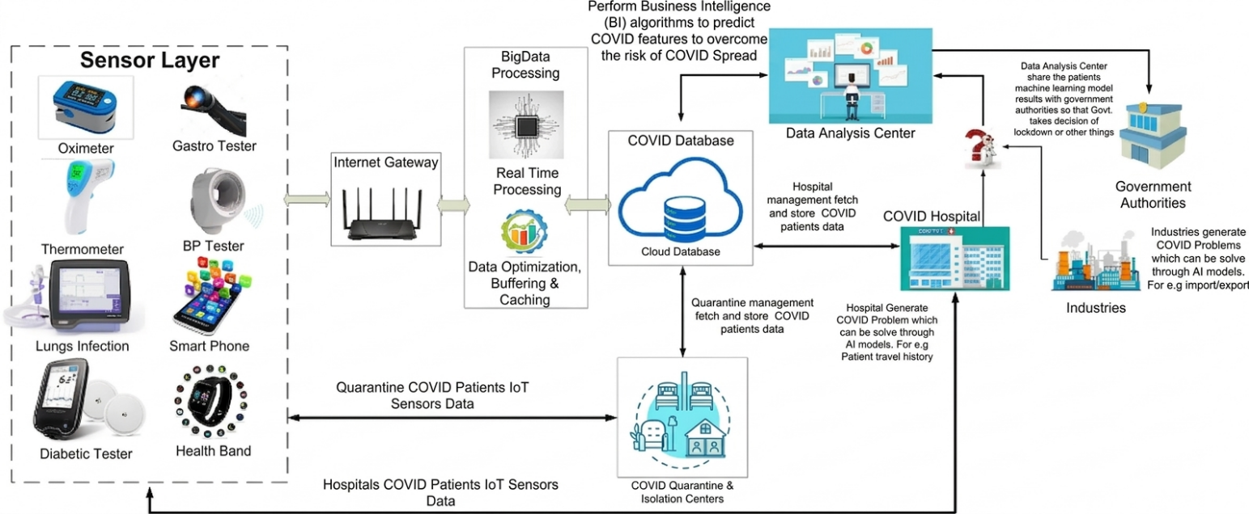
Use Case : Epidemeilogy
Applications of Big Data Analytics to Control COVID-19 Pandemic
Citation : https://pmc.ncbi.nlm.nih.gov/articles/PMC8037067/

Slide 8
Thank you
Q&A

